Slide 1
Welcome to CS 211

Slide 2
Course Websites
Canvas (now at canvas.Humboldt.edu) is the central hub for the course
Github (https://github.com/acarteas/Teaching-DataStructures/tree/2018-Spring) will be used to store all course materials: course syllabus, official calendar, assignment descriptions, and other course documents

Slide 3

Recommended Reading

Slide 4
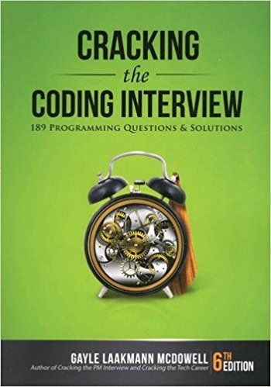
More Recommended Reading

Slide 5
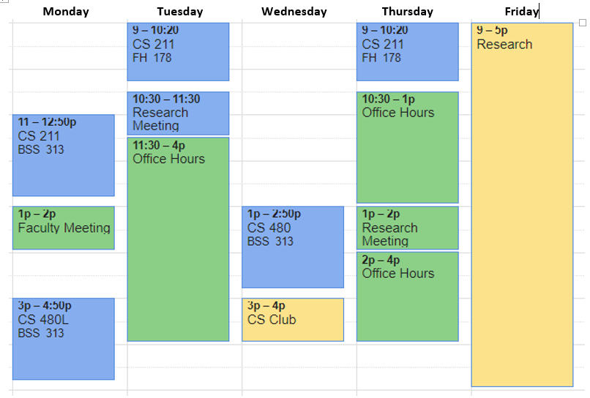
Adam’s Schedule

Slide 6
Programming Environments
You can use either Visual Studio (C#) or Android Studio (Java)
Target Android version: 7.0 (maybe 6.0)

Slide 7
Grades
Participation (20%)
Assignments (60%)
Final Project (20%)

Slide 8
Final grade translations
93.00 – 100.00 | A | 71.00 – 75.99 | C
90.00 – 92.99 | A- | 69.00 – 70.99 | C-
87.00 – 89.99 | B+
82.00 – 86.99 | B | 60.00 – 68.99 | D
78.00 – 81.99 | B- | 00.00 – 59.99 | F
76.00 – 77.99 | C+

Slide 9
Participation
Attendance in class is mandatory and will be collected throughout the semester.
Because this is a lab-based course that is focused on generating deliverables, it is necessary that you maintain a low absence rate.
Missing more than 5 courses may result in a failing grade regardless of marks earned from other categories.

Slide 10
Homework Policy
To receive full credit on a homework, you must submit your work by the stated deadline. Work may be turned in late for reduced credit.

Slide 11
Final Project
A final, team-based project takes the place of a more traditional final exam in this course.
Mid-way through the semester, you will submit a proposal for your final project.

Slide 12
Whiteboard Interviews
Each student will undergo a whiteboard interview in front of the class.
To prepare, I recommend reading “Cracking the Coding Interview”
Dates will be assigned on Monday.

Slide 13
A Note on Cheating
Don't do it!
See syllabus for examples of cheating.

Slide 14
Structuring this class
A recent job shadow at Microsoft over Thanksgiving break has cast doubts as to the efficacy of traditional teaching methods
Result: I’m trying something new!
This is a “learn by doing” class.
Very little traditional “teaching”
I will not be spending a lot of time in front of class talking at you.
Instead, I will be focusing on helping the entire class DO to the best of their abilities.
I am gong to be the class’ cheerleader
By the end of this course, a successful (i.e. A) student will have 4 strong deliverables on GitHub

Slide 15
This will likely be a difficult class
It is expected that you are motivated to learn.
It is expected that you are capable of and willing to put in a lot of out-of-class time into this course.
It is expected that you are already a reasonable programmer (in student terms).
If you got a C from me in 211 and haven’t improved, expect to struggle.
If you got a C or B (possibly even an A) in 211 and I wasn’t your instructor, expect to struggle.
This all sounds scary, but I guarantee that anyone that puts in time and effort will pass this course.

Slide 16
What to expect in my course: A review from a prior student
On the rare occasion when the course material presented in class was actually relevant to the course assignments we were given. Most of the time there was not at all enough relevant instruction in class for the assignments given that were worth a large part of our grade. I found myself always needing to use outside resources to learn the material in order to complete assignments, because the relevant instructional material just did not exist as part of class instruction…
…It is insanely unreasonable for a professor to expect students to spend 20 or sometimes more hours per week using outside resources trying to understand what the professor's starter code does, what needs to be done to complete the assignment, how the data structures necessary work in c++, and then how to use the data structure to solve the problem. It was not at all unusual for this to take me and many other people in the class who I spoke to up to or more than 20 hours per week…
…I do not pay thousands of dollars per semester for my education just to have to spend basically the equivalent of a part time job Googling my education on top of that because I'm not getting the information I need to complete the course assignments from my professor's instruction.

Slide 17
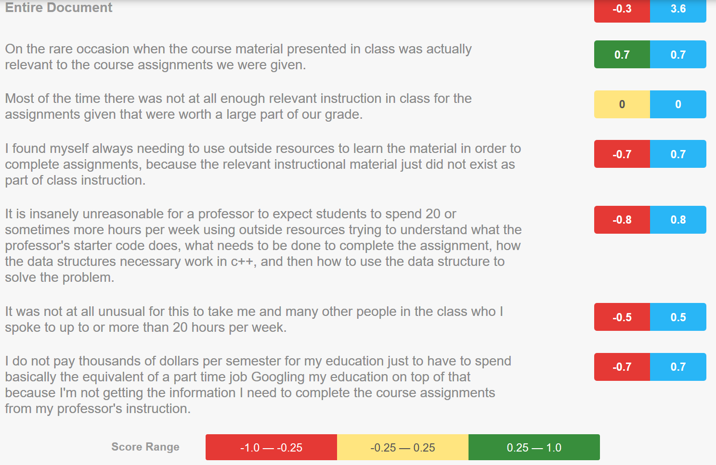

Slide 18
I want this to be your favorite class
Every assignment will be up to you!
Of course, I will provide suggestions for those that need it
You are in charge of your learning outcomes!
From Sonmez
“No one can teach you anything.”
Make learning your responsibility
Focus on actually learning and applying what you learn as much as possible

Slide 19
I want this to be a useful class
This class is going to double as the professional skills course that you should have taken but HSU doesn’t offer
If approached correctly, you will have 4 amazing projects in your portfolio that you can showcase to employers
Sonmez: “One of the biggest problems new graduates have is that since they don’t have any experience, they can’t get experience”
Sonmez: “College is the perfect time to build your portfolio…”
Sonmez: Merely doing textbook learning and assignments (i.e. most of what you’ve done at HSU) are insufficient to land the job you really want

